Slide 1
Heat Transport
NE 591

Slide 2
Last Time
Mining -> Processing -> Conversion -> Enrichment -> Powder -> Compaction/Sintering -> Rod/Assembly
U₃O₈ must be converted to UF₆ for enrichment, which is then converted to UO₂ powder for pellet manufacture
For different fuel types, enriched UF₆ follows a different path

Slide 3
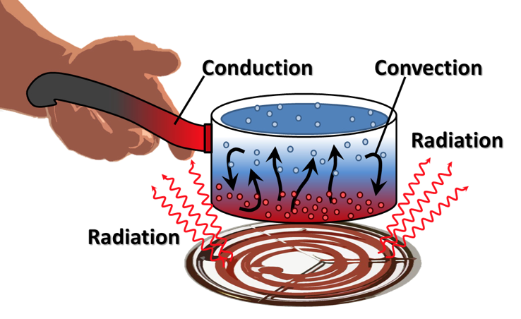
Last Time
General heat transport
Heat is produced in the fuel, transports through the cladding and gap, and into the coolant
The geometry of our problem
The initial condition of T
The boundary conditions of T
Is each parameter is a function of T
Thermal conductivity, heat capacity
Function of space/time?
Heat generation, dependent upon flux

Slide 4
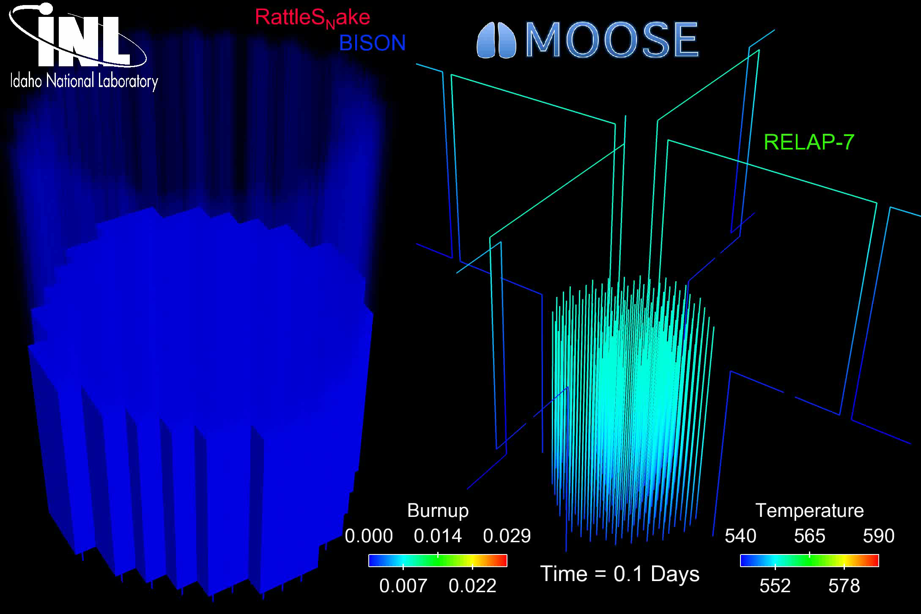
The most accurate solution is numerical, in 3D, requires modeling the entire core, and is multi-physics
Solution is 3D and changes in time
All the properties are functions of temperature
The boundary conditions comes from information about the coolant flow
The heat generation rate comes from information about the neutronics in the reactor
No analytical solution is possible

Slide 5
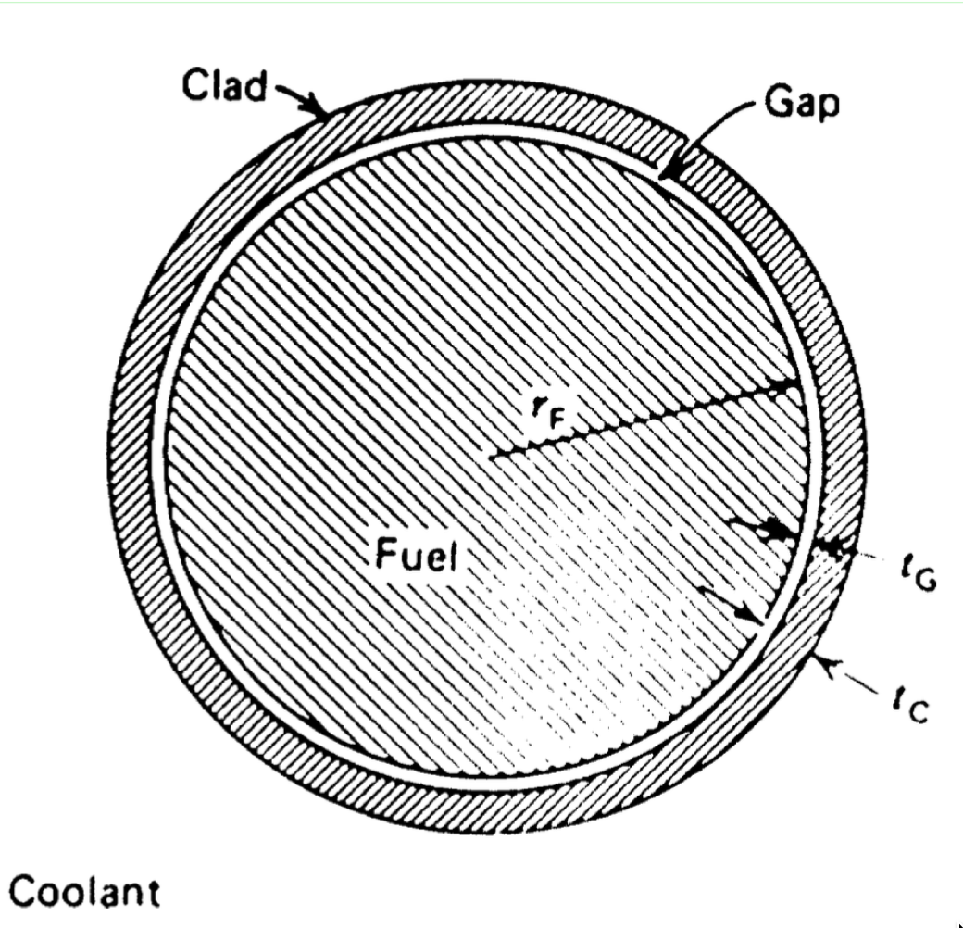
In order to solve, make assumptions!
#1: steady state ->
#2: axisymmetric ->
#3: constant in z
#4: constant thermal conductivity

Slide 6
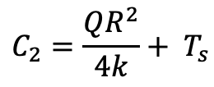
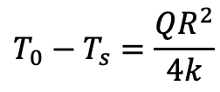
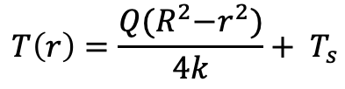
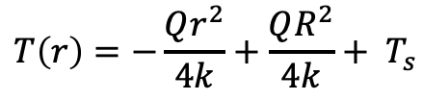
Directly Solving for Temperature Profile
Boundary conditions: r₀ = 0, r₁=R, T’(0) = 0, T(R) = T_{s}
r0
r1
$$C_{2}=\frac{QR^{2}}{4k}+ T_{s}$$
$$T\left(r\right)=−\frac{Qr^{2}}{4k}+\frac{QR^{2}}{4k}+ T_{s}$$
$$T\left(r\right)=\frac{Q{(R}^{2}−r^{2})}{4k}+ T_{s}$$
$$T_{0}−T_{s}=\frac{QR^{2}}{4k}$$

Slide 7
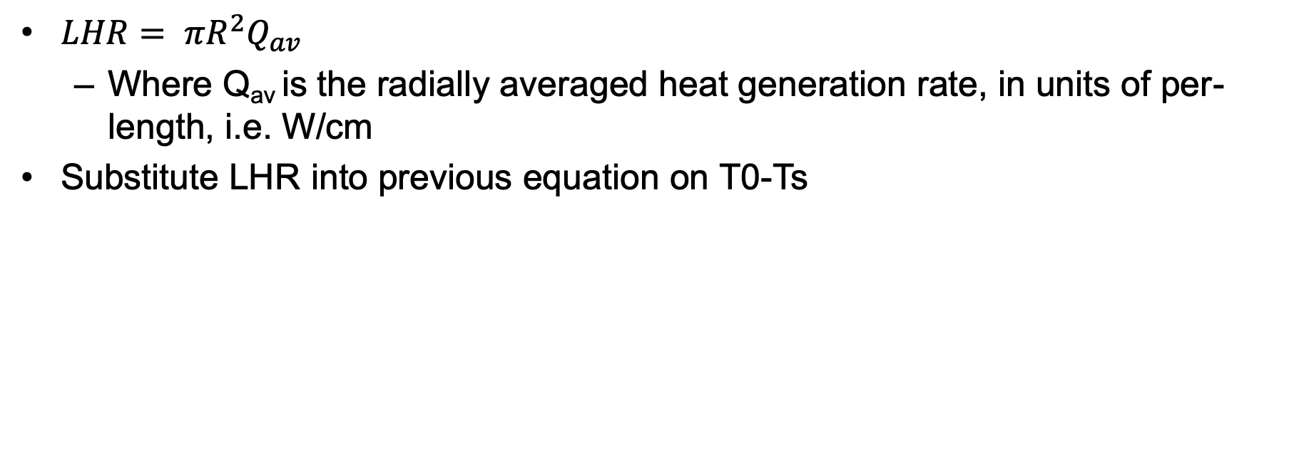
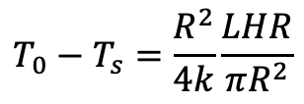
Linear Heat Rate
$LHR= πR^{2}Q_{av}$
Where Q_{av} is the radially averaged heat generation rate, in units of per-length, i.e. W/cm
Substitute LHR into previous equation on T0-Ts
$$T_{0}−T_{s}=\frac{R^{2}}{4k}\frac{LHR}{πR^{2}}$$

Slide 8
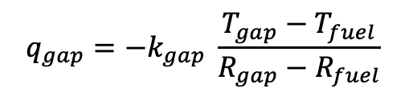
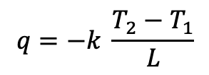
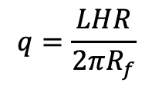
Heat transport through the gap
R₀=0
R₁=R_{f}
R₂=R_{g}
The heat flux gives the rate, per unit area, at which heat flows in a given direction
The heat flux from the fuel is the LHR/pellet circumference
Heat flux from the fuel is the same as heat flux into the gap
Gap thickness = R_{g}-R_{f} = t_{g}
Cladding thickness = R_{c}-R_{g} = t_{c}
$$q=−k \frac{T_{2}−T_{1}}{L}$$
$$q_{gap}=−k_{gap} \frac{T_{gap}−T_{fuel}}{R_{gap}−R_{fuel}}$$
$$q=\frac{LHR}{2πR_{f}}$$
R₃=R_{c}

Slide 9
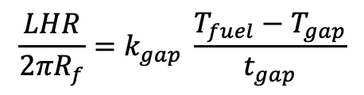
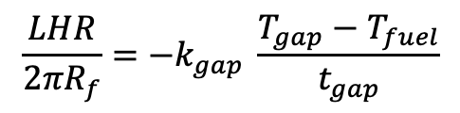
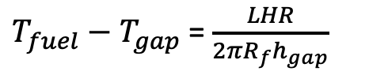
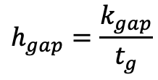
Heat transport through the gap
Set heat flux fuel/gap equal
Gap conductance is defined as:
Gap conductance depends on the gas filling the gap
For pure He, k_{gap}=16x10⁻⁶ * T^{0.79} (W/cm-K)
For pure Xe, k_{gap}=0.7x10⁻⁶ * T^{0.79} (W/cm-K)
Simple mixing rule: k_{gap} = k_{He}^{1-y} x k_{Xe}^{y}
$$\frac{LHR}{2πR_{f}}=−k_{gap} \frac{T_{gap}−T_{fuel}}{t_{gap}}$$
$$\frac{LHR}{2πR_{f}}=k_{gap} \frac{T_{fuel}−T_{gap}}{t_{gap}}$$
$$h_{gap}=\frac{k_{gap}}{t_{g}}$$
$T_{fuel}−T_{gap}$ = $\frac{LHR}{2πR_{f}h_{gap}}$

Slide 10
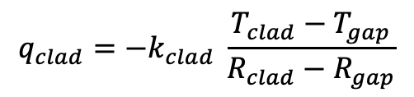
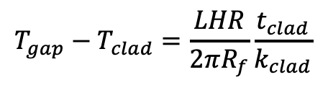
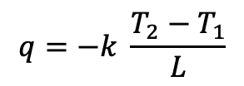
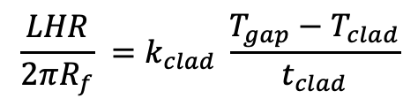
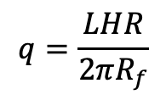
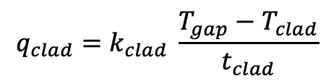
Heat transport through the cladding
$$q=−k \frac{T_{2}−T_{1}}{L}$$
$$q_{clad}=−k_{clad} \frac{T_{clad}−T_{gap}}{R_{clad}−R_{gap}}$$
Heat flux through the cladding
Set equal your heat fluxes
My nomenclature is often also seen where T_{gap} = T_{CI}, T_{clad} = T_{CO}
$$q=\frac{LHR}{2πR_{f}}$$
$$q_{clad}=k_{clad} \frac{T_{gap}−T_{clad}}{t_{clad}}$$
$$\frac{LHR}{2πR_{f}} =k_{clad} \frac{T_{gap}−T_{clad}}{t_{clad}}$$
$$T_{gap}−T_{clad}=\frac{LHR}{2πR_{f}}\frac{t_{clad}}{k_{clad}}$$

Slide 11
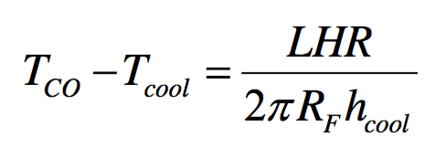
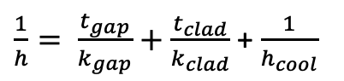
Heat transfer to the coolant
Heat is transported from the cladding to the coolant via convection
T_{cool} is the coolant temperature, h_{cool} is the convective heat transfer coefficient between cladding wall and coolant
Adding gap + cladding + coolant:
$\frac{1}{h}= \frac{t_{gap}}{k_{gap}}+$ $\frac{t_{clad}}{k_{clad}}$ + $\frac{1}{h_{cool}}$

Slide 12
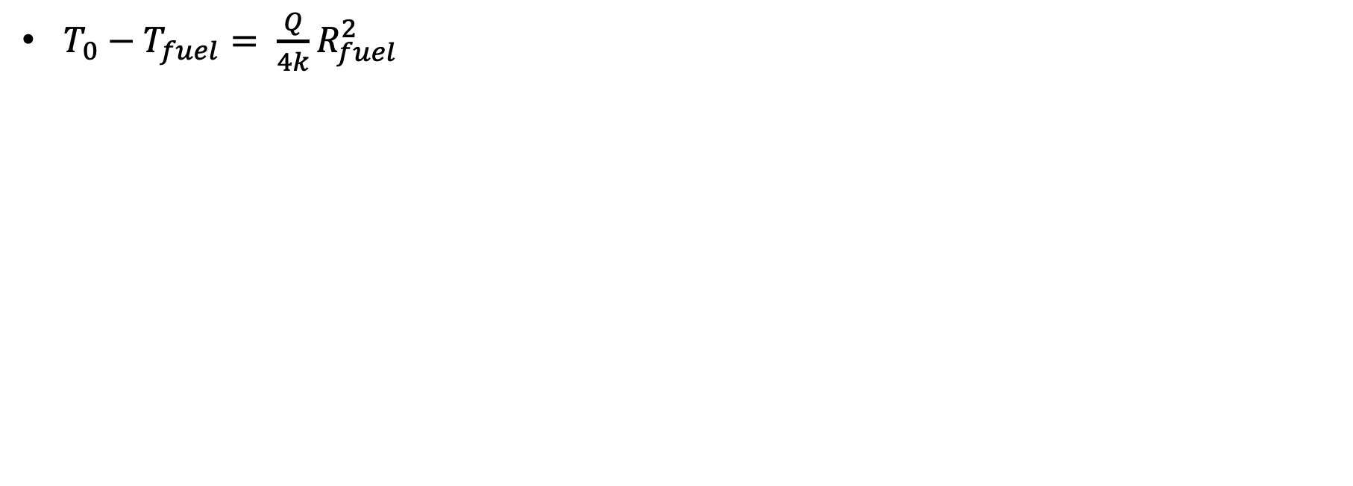
Summary of analytical solutions
$T_{0}−T_{fuel}= \frac{Q}{4k}R_{fuel}^{2}$

